Slide 1
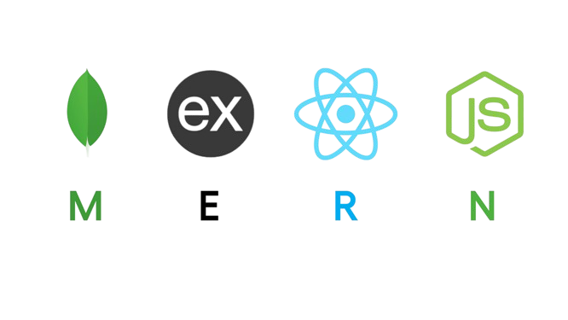
Recent Trend & Technology
MERN Stack

Slide 2
What is the MERN stack?
The MERN stack is a collection of technologies used to build modern web applications. It includes MongoDB (database), Express.js (backend framework), React (frontend library), and Node.js (runtime environment).
MongoDB: A NoSQL database that stores data in JSON-like documents, allowing for flexible and scalable data management.
Express.js: Express is used to simplify building web applications and APIs by providing robust features for routing, middleware, and handling HTTP requests and responses.
React: A front-end library developed by Facebook for building user interfaces with reusable components.
Node.js: A JavaScript runtime built on Chrome’s V8 engine that enables server-side scripting and building scalable network applications.

Slide 3
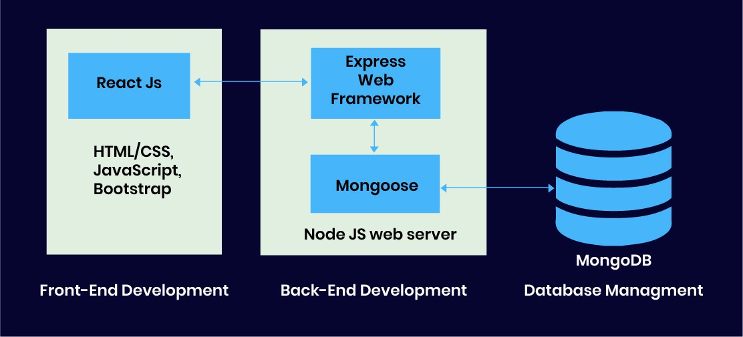
How does the MERN Stack work?
The MERN architecture allows you to easily construct a 3-tier architecture (frontend, backend, database) entirely using JavaScript and JSON.

Slide 4
Benefits
Full-stack JavaScript: You use one language, JavaScript, for the whole project, making development easier.
Scalability and Flexibility: MERN stack applications are highly scalable and flexible due to the non-blocking nature of Node.js and the schema-less nature of MongoDB.
Strong Community Support: Each component of the MERN stack has a strong, active community, which provides extensive resources, libraries, and support.
Single Language: Easy to switch between client-side and server-side code.

Slide 5
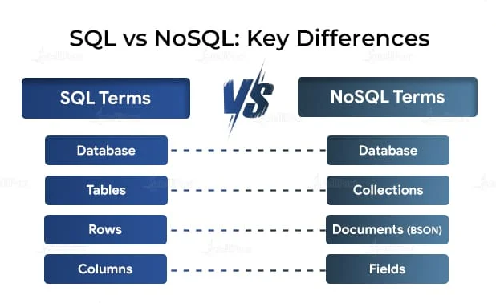
MongoDB
Open-source document-oriented database.
It stores data in JSON format.
Schema Less - Any type of data in a separate document.
Use of JavaScript - MongoDB uses JavaScript which is the biggest advantage.

Slide 6
NodeJS
JavaScript run-time environment built on Chrome's V8 JavaScript.
Node.js allows you to run JavaScript on the server.
Ryan Dahl developed Node.js in 2009 and It is free & open source, written in C++.
It supports back-end services such as APIs.

Slide 7
ExpressJS
Flexible Node.js framework that provides robust set of features for web application and mobile application.
It provides easy routing of requests based on HTTP methods and URLs.
It allows to set up middlewares to respond to HTTP Requests.
Allows to dynamically render HTML Pages based on passing arguments to templates.

Slide 8
ReactJS
React is used to build single-page applications.
A JavaScript library for building user interfaces for web and mobile applications.
React allows us to create reusable Ul components.
React-router to handle the front-end routing.
React was created by Jordan Walke, a Software Engineer at Facebook.

Slide 9
Why to use React?
JSX (JavaScript XML) makes it easier and simpler to write React components.
ReactJS supports Components. These components also promote code reusability and make the overall web application easier to understand and debug.

Slide 10
What we will cover
React Component
React Hooks
React Router
MongoDB Schema
Express Api

Slide 11
Installation
MongoDB
Download community edition mongoDB
https://fastdl.mongodb.org/windows/mongodb-windows-x86_64-7.0.12-signed.msi
Node
Create folder server
cd server
npm init –y // for creating package.json file
Express
npm i express // run in the server folder
React
npx create-react-app appName
cd appName
npm start

Slide 12

Thank you
https://github.com/omnakum2
https://github.com/princegadhiya1504

